Slide 1


Slide 2
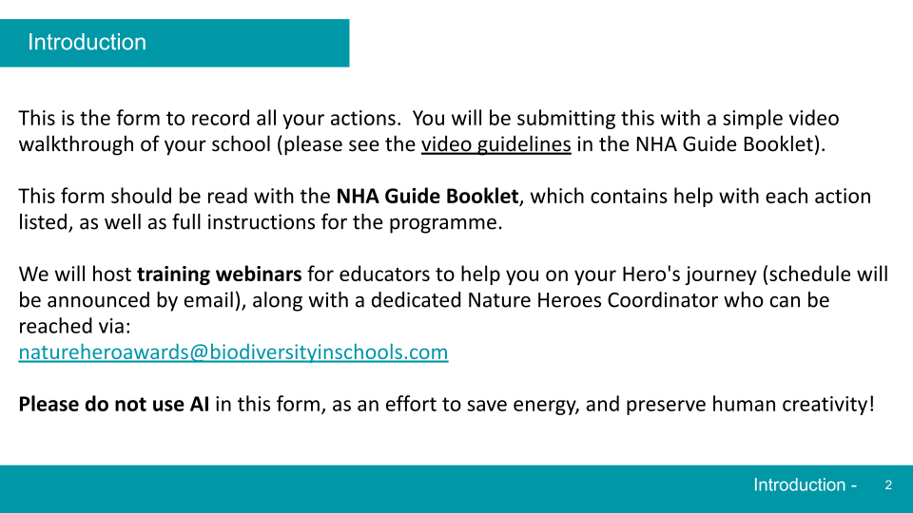

Slide 3
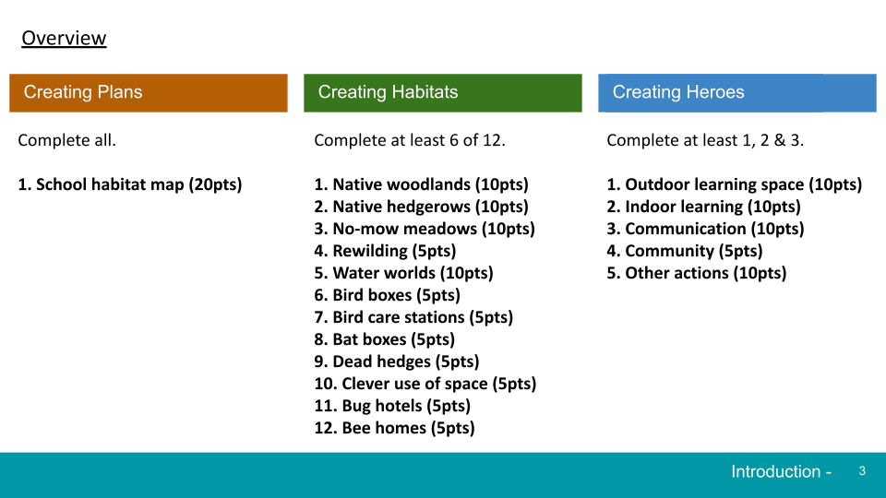

Slide 4
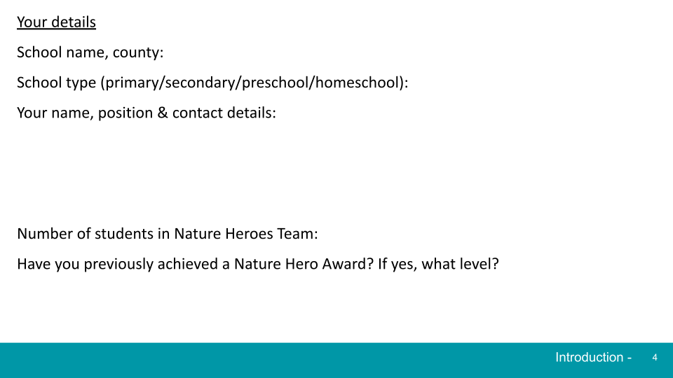

Slide 5
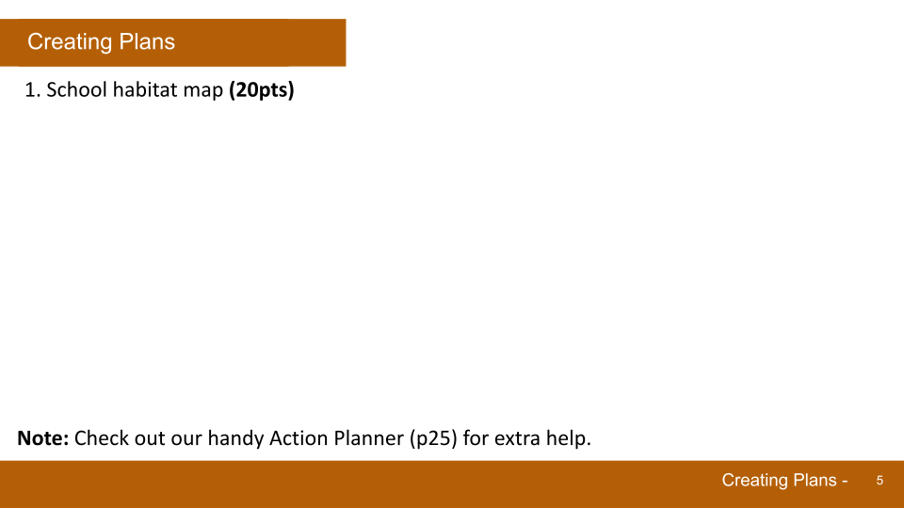
Insert picture(s) here

Slide 6
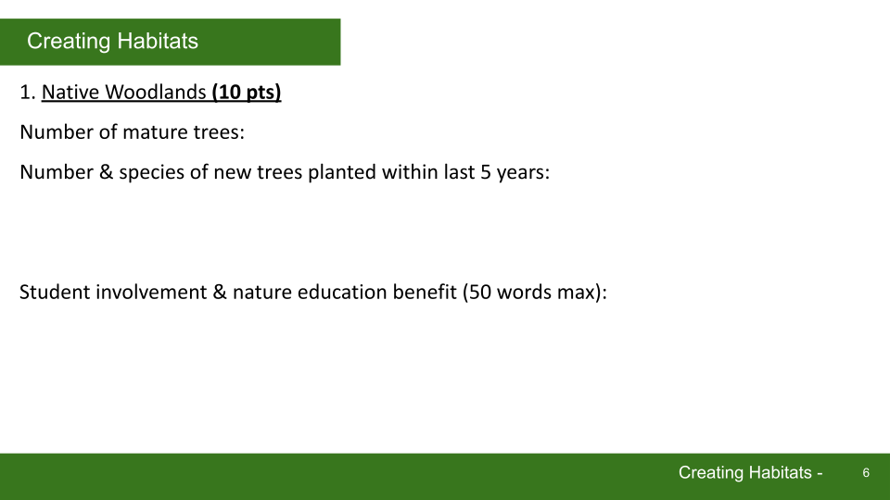
Completed / Not completed (delete as appropriate)

Slide 7
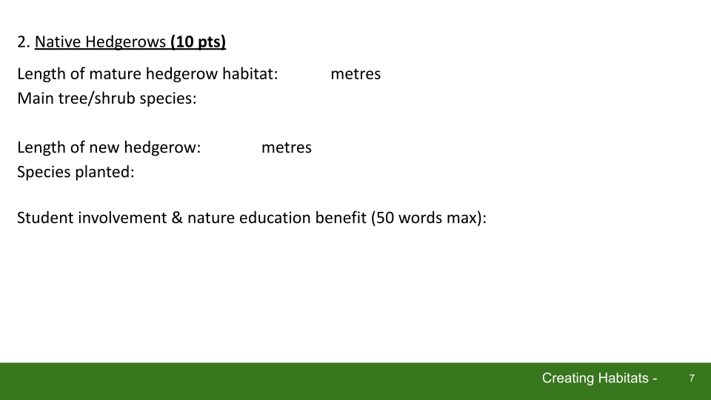
Completed / Not completed

Slide 8
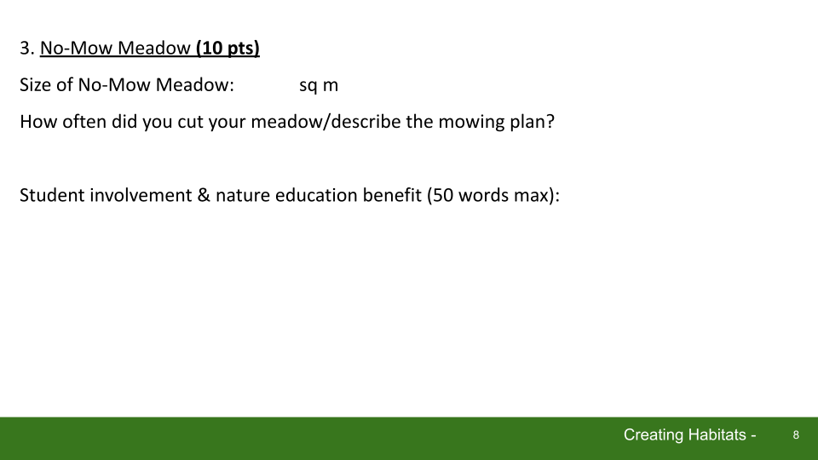
Completed / Not completed

Slide 9
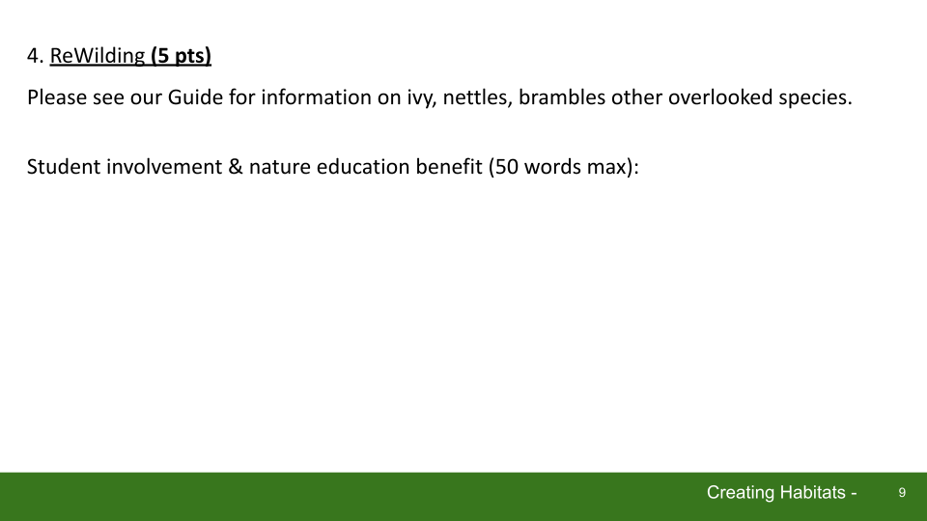
Completed / Not completed

Slide 10
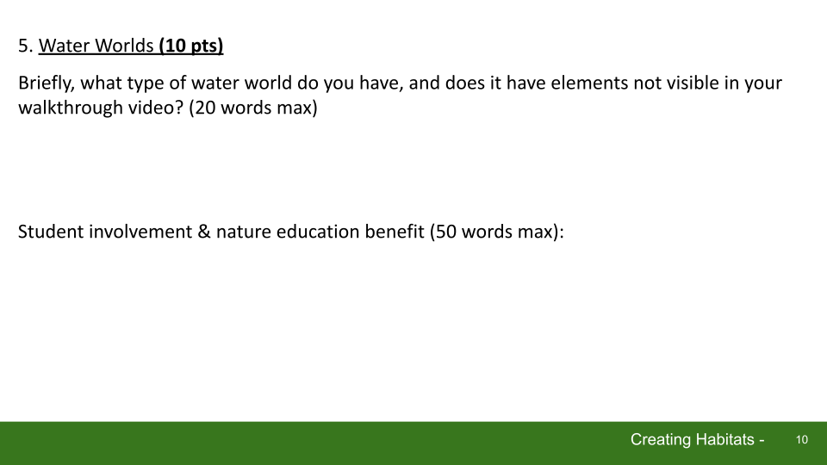
Completed / Not completed

Slide 11
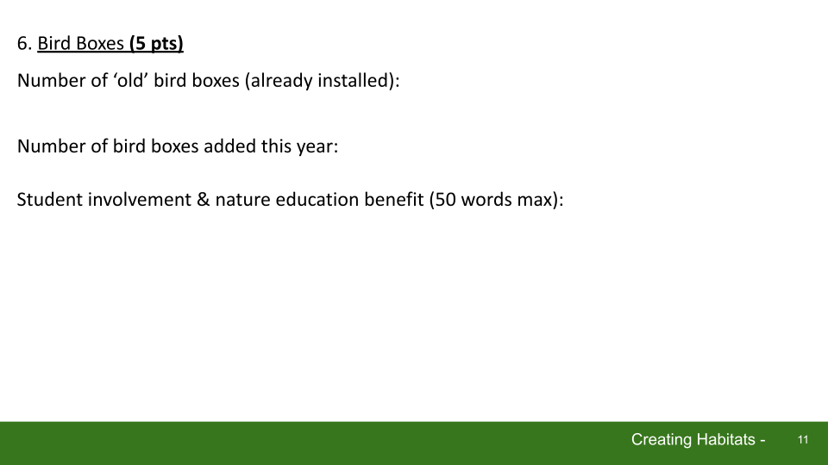
Completed / Not completed

Slide 12
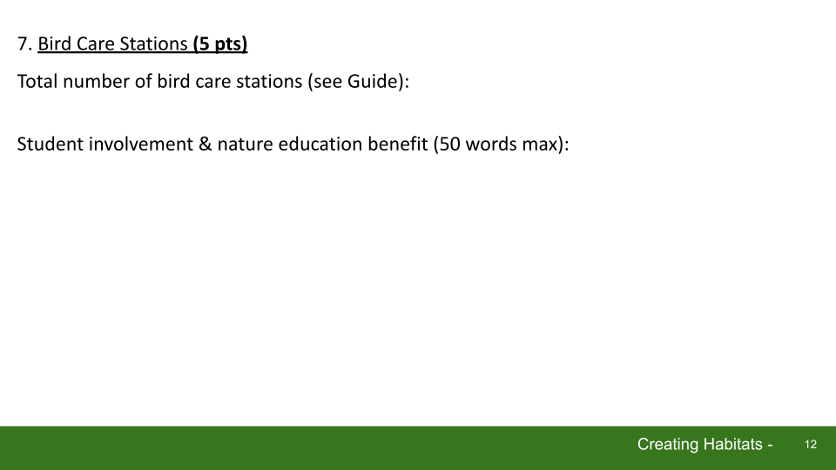
Completed / Not completed

Slide 13

Completed / Not completed

Slide 14
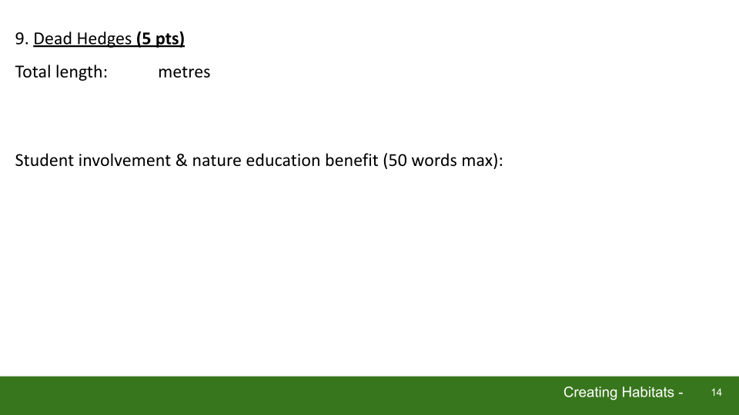
Completed / Not completed

Slide 15
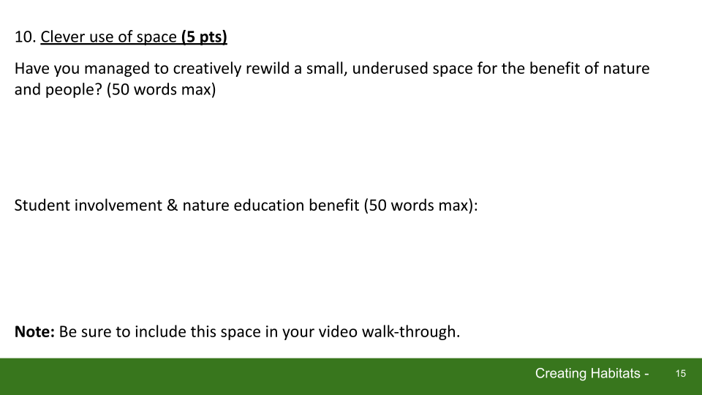
Completed / Not completed

Slide 16
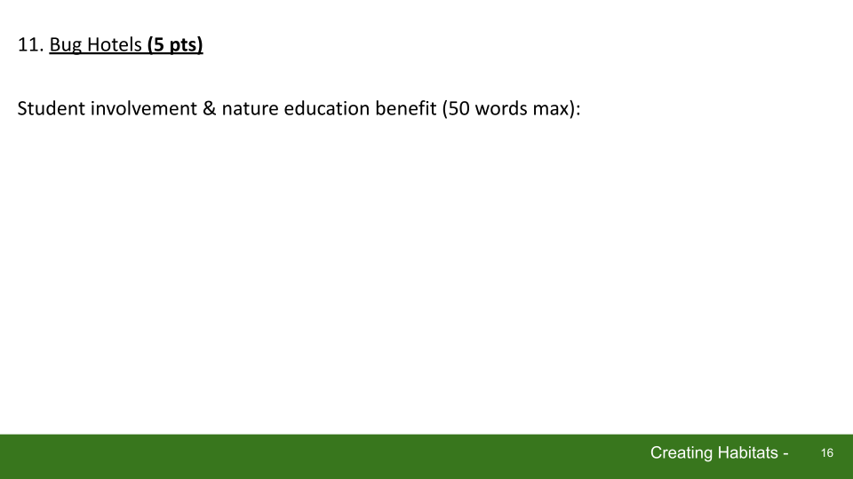
Completed / Not completed

Slide 17
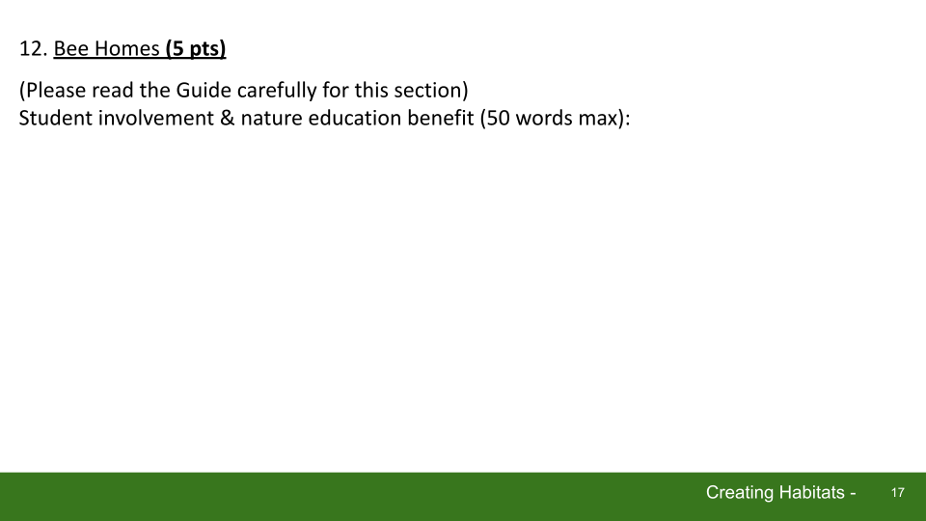
Completed / Not completed

Slide 18
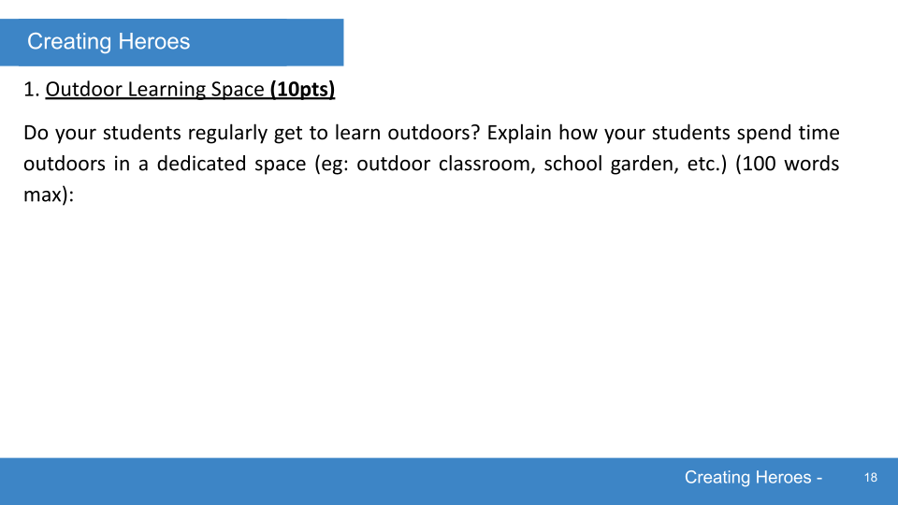
Completed / Not completed

Slide 19
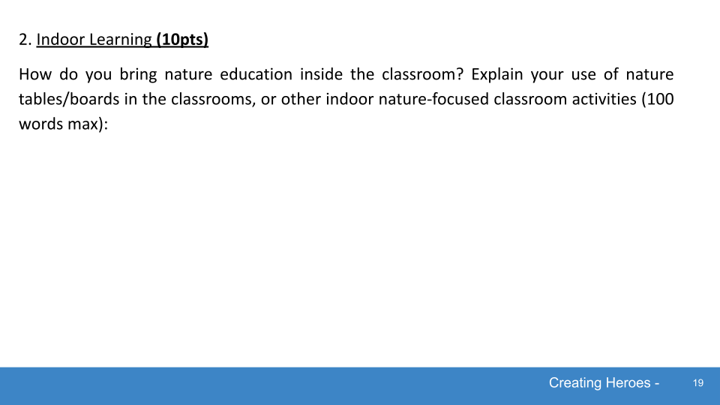
Completed / Not completed

Slide 20
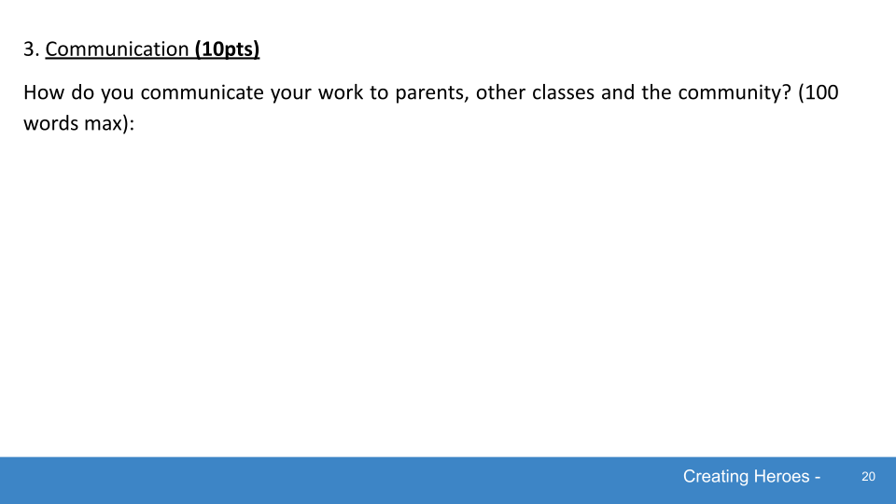
Completed / Not completed

Slide 21
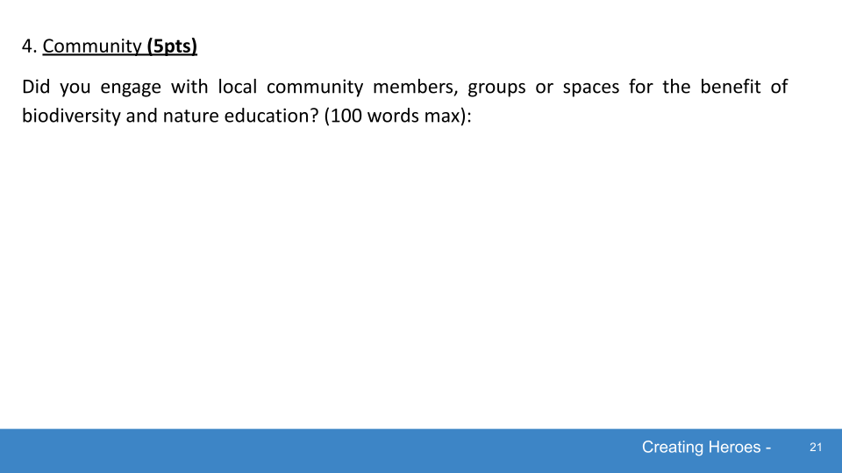
Completed / Not completed

Slide 22
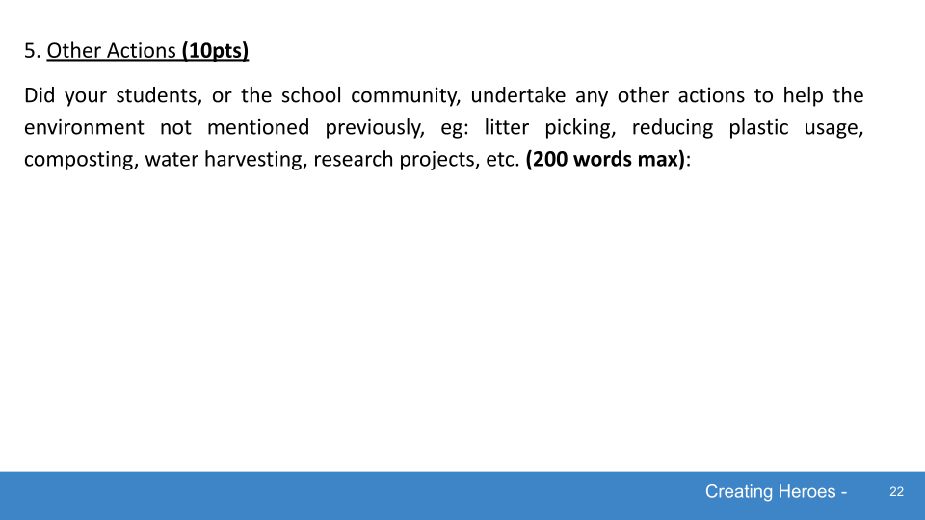
Completed / Not completed

Slide 23
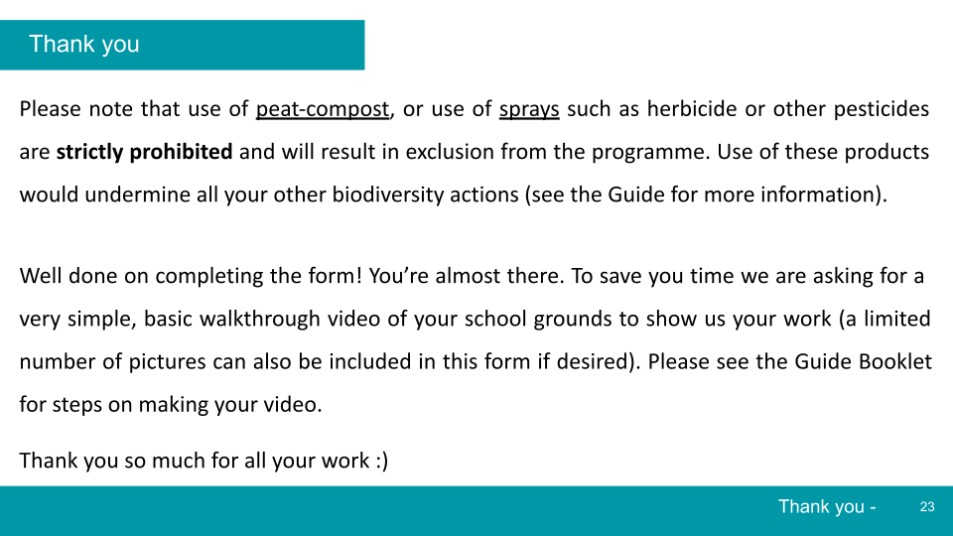

Slide 24
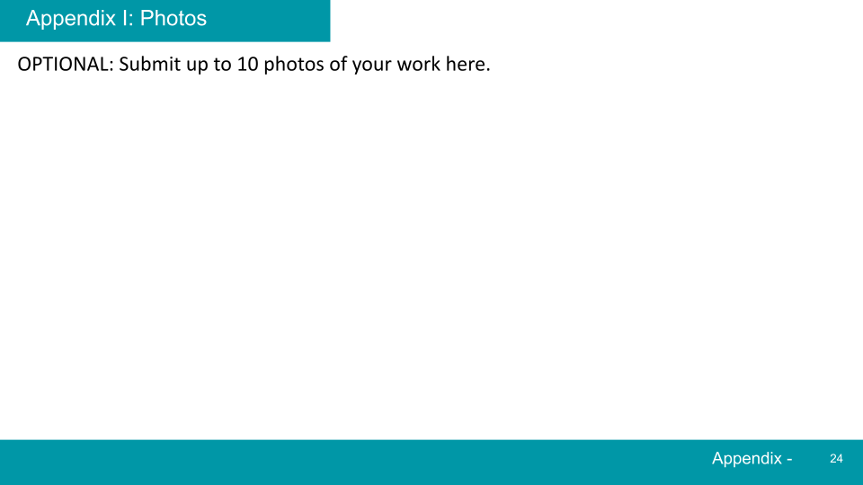
Insert photos here

Slide 25
Appendix II: Action Planner
OPTIONAL: Use the organiser below to plan when you will undertake certain parts of the programme (Date, Month, Season or year-round, ‘D/M/S’).
Print out, or edit the slide as desired (right click the boxes to see the check mark option, in Google Slides)
I: Plans | D/M/S | ✔ | II: Habitats | D/M/S | ✔ | II: Habitats (ctd) | D/M/S | ✔ | III: Heroes | D/M/S | ✔
School Habitat Map |  |  | Native Woodland |  |  | Bird care station |  |  | Outdoor Learning
Plan the year |  |  | Native Hedgerows |  |  | Bat boxes |  |  | Indoor Learning
Take video |  |  | No-mow meadows |  |  | Dead hedge |  |  | Community
Submit all files |  |  | ReWilding |  |  | Clever use of space |  |  | Community
 |  |  | Water Worlds |  |  | Bug hotel |  |  | Other actions
 |  |  | Bird boxes |  |  | Bee banks &c.
Appendix -

